Slide 1

Feature Selection with Genetic Algorithms
Bc. Jozef Varga

Slide 2
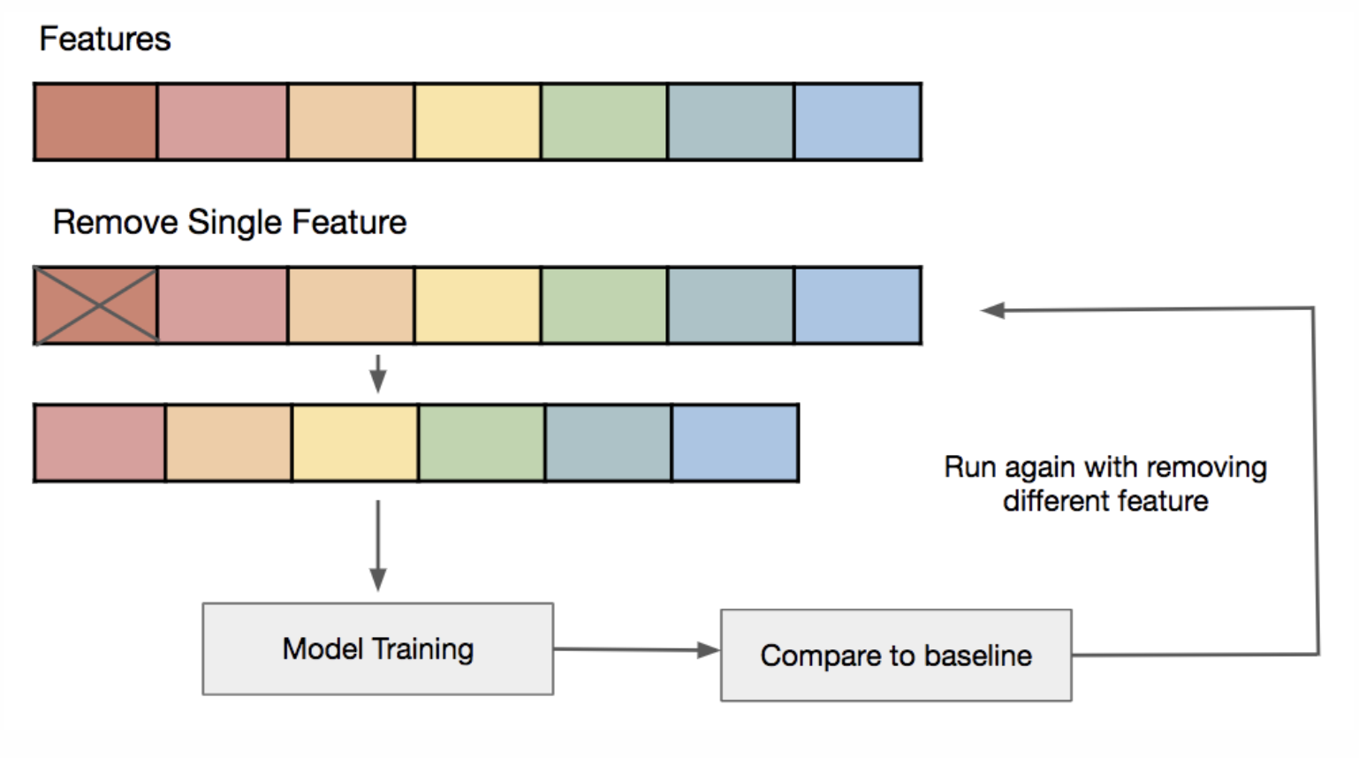
Feature Selection
https://www.kdnuggets.com/2019/10/feature-selection-beyond-feature-importance.html

Slide 3
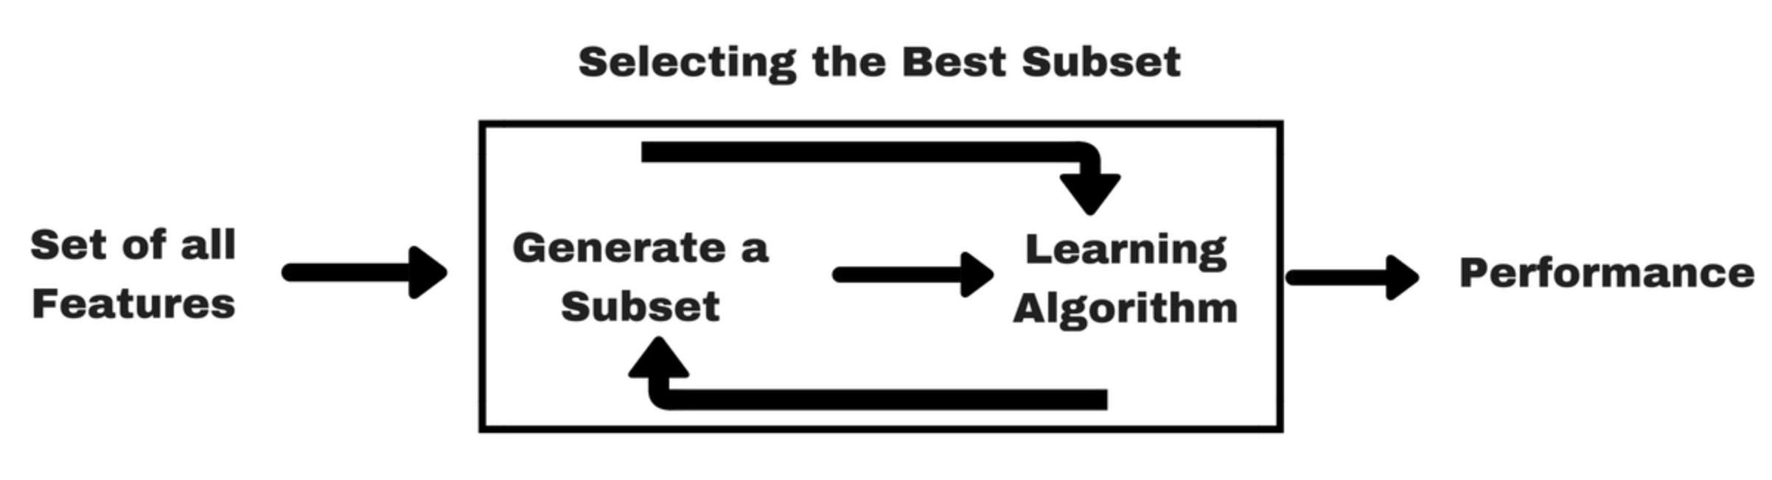
Feature Selection
https://www.analyticsvidhya.com/blog/2016/12/introduction-to-feature-selection-methods-with-an-example-or-how-to-select-the-right-variables/

Slide 4
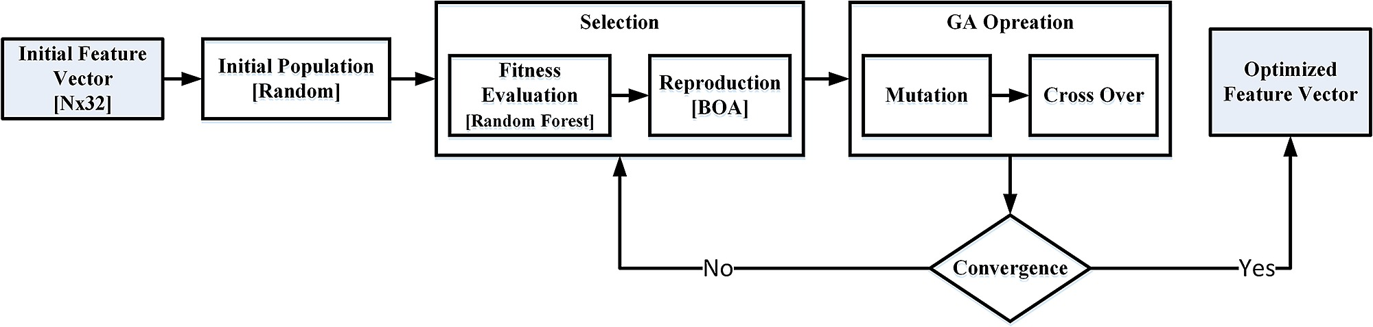
Block diagram of feature selection stage using Genetic Algorithm
https://figshare.com/articles/_Block_diagram_of_feature_selection_stage_using_Genetic_Algorithm_/1508946/1

Slide 5
Zdroje
LIMA DO NASCIMENTO, Tuany Mariah, et al. An investigation of genetic algorithm-based feature selection techniques applied to keystroke dynamics biometrics. 2019.
ZALASIŃSKI, Marcin; CPAŁKA, Krzysztof. A Method for Genetic Selection of the Dynamic Signature Global Features’ Subset. In: International Conference on Information Systems Architecture and Technology. Springer, Cham, 2017. p. 73-82.
SINGH, D. Asir Antony Gnana, et al. Dimensionality reduction using genetic algorithm for improving accuracy in medical diagnosis. International Journal of Intelligent Systems and Applications, 2016, 8.1: 67.

